Slide 1
SAP BTP Build Apps Training
Day 16
Anubhav Oberoy
www.AnubhavTrainings.com
Follow excellence with sheer passion

Slide 2


DISCLAIMER
The training content and delivery of this presentation is confidential, and cannot be recorded, or copied and distributed to any third party, without the written consent of Anubhav Trainings

Slide 3
Agenda – Day 16
01
Get Mass data
02
Chart Control
03
Build Code

Slide 4
console.log(inputs.arrayOfObjects);
let mainArray = inputs.arrayOfObjects;
//Step 1: Extract the courses data from each basket
const allCourses = mainArray.flatMap(item => item.courses);
//Step 2: Process the batch of JSONs convert it to a array of strings
const arrOfString = allCourses.map(item => JSON.stringify(item));
//Step 3: Send it out which later can be saved in cloud store
return { result: arrOfString };

Slide 5
Title
// Step 2: Summarize total price per course name
const courseSummary = Object.values(
allCourses.reduce((acc, course) => {
if (!acc[course.name]) {
acc[course.name] = {
name: course.name,
totalPrice: 0,
count: 0
};
}
acc[course.name].totalPrice += course.price;
acc[course.name].count += 1;
return acc;
}, {})
);

Slide 6
What is Build Code
SAP Build Code is a newer offering introduced to bring pro-code and low-code worlds closer together. It targets professional developers with tools that improve productivity and reduce boilerplate coding.
SAP Build Code Combines:
CAP (Cloud Application Programming Model): A powerful framework for building full-stack apps.
AI-Powered Code Generation: Helps accelerate development with smart code suggestions.
Preconfigured Development Environment: Based on Business Application Studio with tooling and templates.
Integrated BTP Services: Seamless connectivity to databases, authentication, and APIs.
Reusable Artifacts: Like data models, logic flows, and UI components.
Think of SAP Build Code as: “Pro-code development, but smarter and faster — with AI and SAP context baked in.”

Slide 7
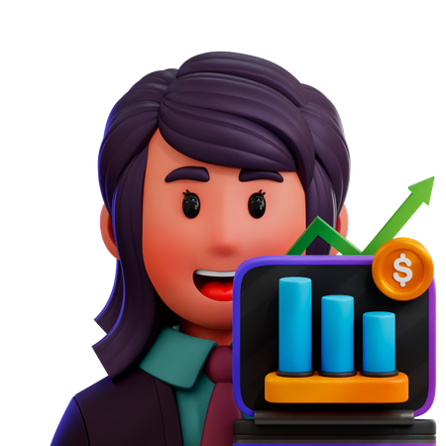
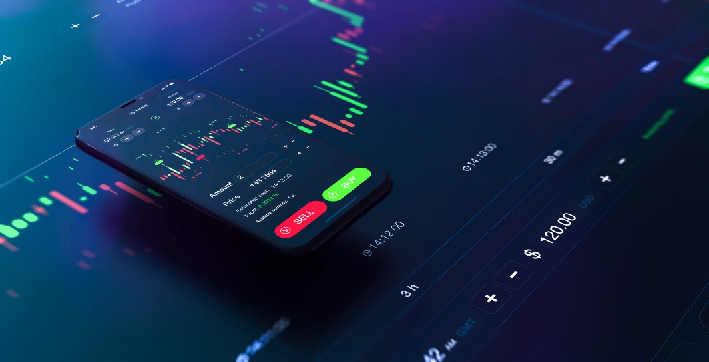
Use Case
Rajesh Mittal
Is a stock market investor, he would like to track his portfolio of stocks by calculating the profit and loss of every security holdings.
He would need an application which can do this work for him, when he add a new stock to his portfolio, he would add qty bought and buying price in the app to do tracking.
create a stock table to stock name, ticker, closingprice, my buying price, qty and date of buy

Slide 8
Title
Content

Slide 9

What We Did
Let’s Summarize

Slide 10

www.anubhavtrainings.com
Thank You
End of Day 14

Slide 11


We’re committed to empower you to be
#FutureReady
through powerful training solutions.
We build the workforce of the future.
250+
Corporate Clients
30,000+
Learners Trained
25000+
Learners Placed
FREE WEBINARS
Sign up for free webinars with industry experts every fortnight!
Enroll Now!
Contact us today!
https://anubhavtrainings.com

